Slide 1
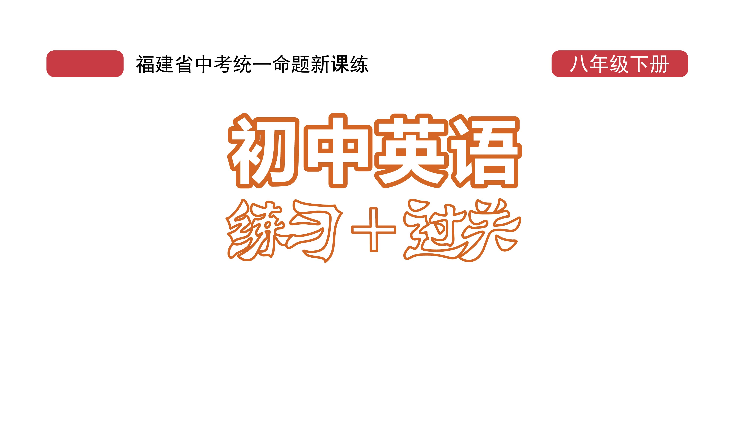
课时练习
模块六 第一章 第三节

Slide 2
一、翻译下列词组。
1. 筹钱 __________________________________
2. 想出一个好主意 ________________________
3. 点一份特别的午餐 ______________________
4. 向某人提供/端上某物 ____________________
5. 打电话回家 ____________________________
raise money
think of a good/great idea
order a special lunch
serve sth. to sb.
call home

Slide 3
一、翻译下列词组。
6. 去春游 _____________________________________
7. 订一张火车票 _______________________________
8. 建议某人做某事 _____________________________
9. 举办一场演出 _______________________________
10. 盼望(做)某事 _______________________________
11. 收到某人的来信 _____________________________
go on a spring field trip
book a train ticket
advise sb. to do sth.
put on a show
look forward to (doing) sth.
hear from sb./get a letter from sb.

Slide 4
二、用括号内所给单词的适当形式填空， 每空不限词数。
1. Toronto is a famous __________ (Canada) city on the bank of Lake Ontario(安大略湖).
2. Little Jack was very _______ (luck) to live through the serious disease.
3. The man is now looking forward to ___________ (return) to work as soon as possible.
Canadian
lucky
returning

Slide 5
二、用括号内所给单词的适当形式填空， 每空不限词数。
4. The price of bitcoins(比特币) changes a lot. Sometimes 1 bitcoin costs more than 10,000 _______ (dollar).
5. The dry season, between July and early October, is the best time ________ (see) the Great Wildebeest Migration(牛羚大迁徙).
dollars
to see

Slide 6
三、情景交际。
1. 你想知道这本英文字典的价格，可以这样问店员：
_______________________________________?
2. 你想知道笔友近况如何，可以在信中这样问：
_______________________________________?
3. 你想知道对方的姓名和电话号码，可以这样问：
May I __________________________________?
What’s the price of the English dictionary
How are you (doing)
have your name and telephone number

Slide 7
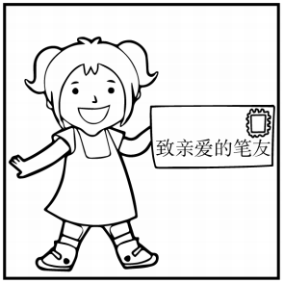
四、看图写话。
1. hear, last week
The girl/She heard from her pen pal last week.

Slide 8
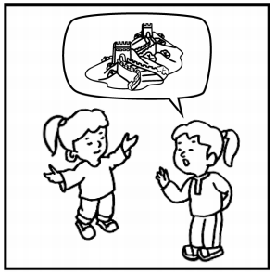
四、看图写话。
2. look forward, visit
The girls are looking forward to visiting Beijing./
They look forward to visiting the Great Wall.

Slide 9
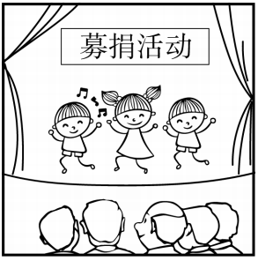
四、看图写话。
3. put on, yesterday
The students/They put on a show to raise money yesterday.

Slide 10
五、熟词生义。
1. draw A. vt. 画 B. vi. 拉；拔出 C. vt. 引起，吸引 D. vt. & vi. 打成平局，不分胜负
_____ (1) The dentist drew out my tooth easily.
_____ (2) Class One and Class Two drew 3–3 in the football match.
B
D

Slide 11
五、熟词生义。
_____ (3) I’ll draw you a map of how to get to my house.
_____ (4) He was waving(挥动) his arms to draw their attention.
A
C

Slide 12
五、熟词生义。
2. cost A. vt. 花费；值…… B. vt. 使失去(生命、 健康等) C. n. 成本，费用
_____ (1) Careless driving cost his life．
_____ (2) He put(给……定价/估值) the cost at one hundred yuan.
_____ (3) A small gift can give a lot of pleasure and doesn’t cost much.
B
C
A

Slide 13


